Slide 1
AI for Bioinformatics

Slide 2
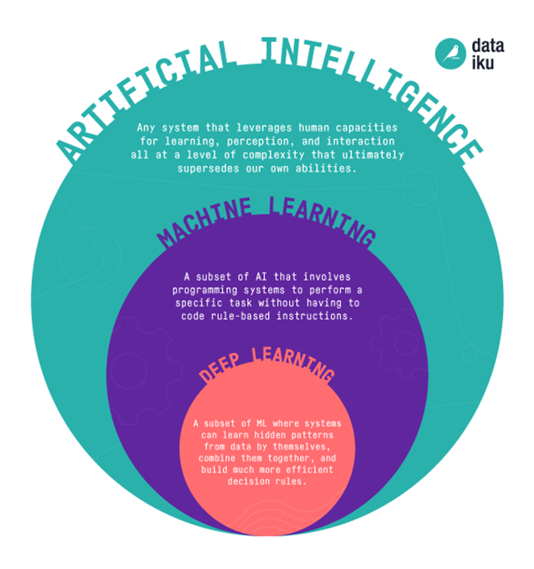
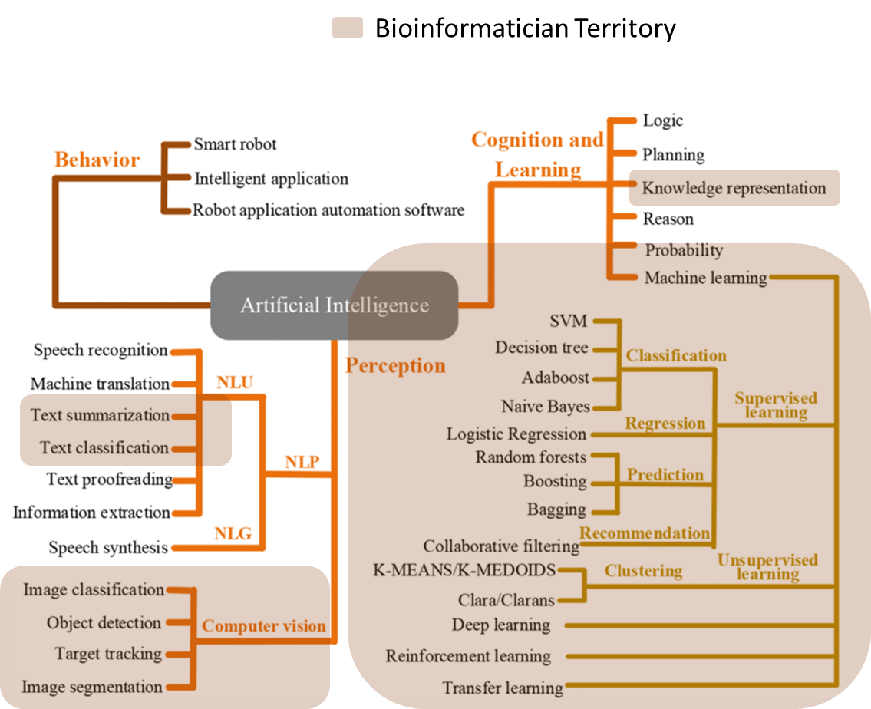
Our Territory as Bioinformatician
https://blog.dataiku.com/ai-vs.-machine-learning-vs.-deep-learning
Wang, L., Liu, Z., Liu, A., & Tao, F. (2021)

Slide 3
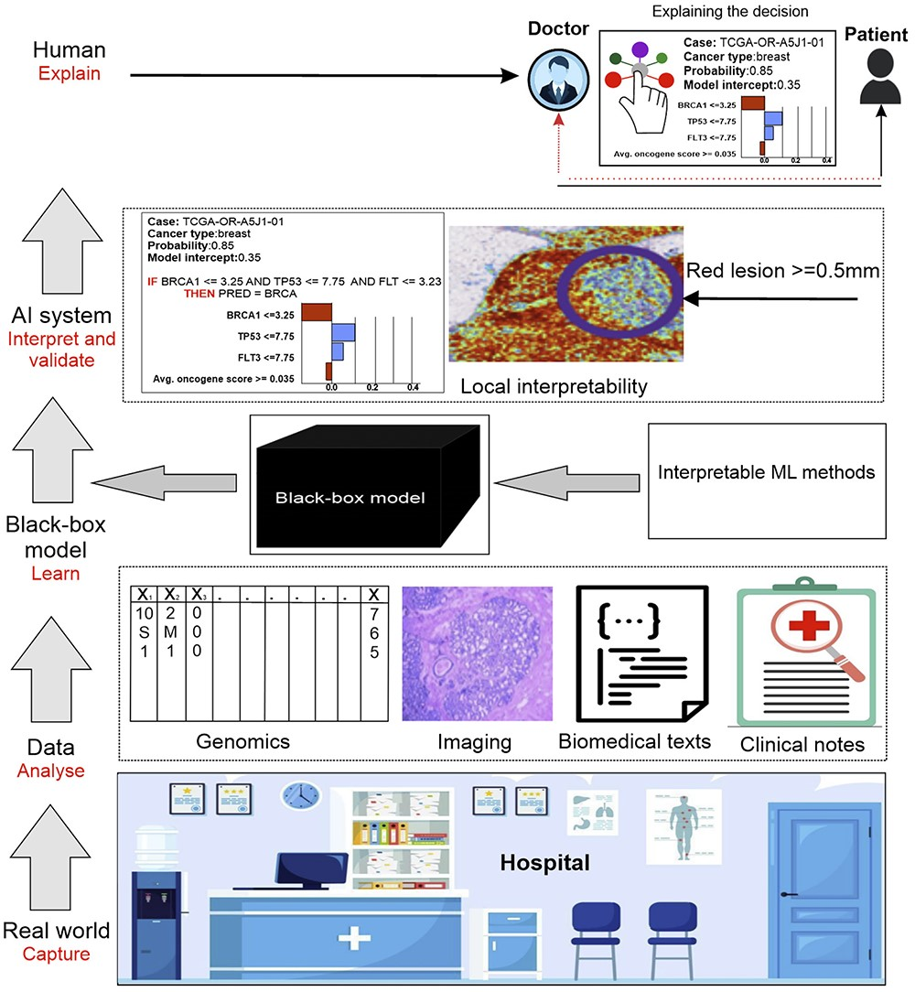
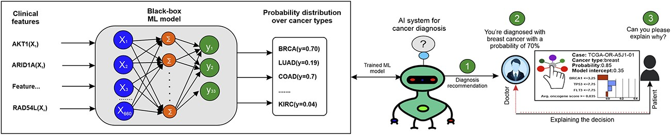

AI we want in short Term
An example of AI
Say: Dataset last updated in 2020
AI we have
AI we AIM in long Term
Karim, M. R., Islam, T., Shajalal, M., Beyan, O., Lange, C., Cochez, M., ... & Decker, S. (2023)

Slide 4


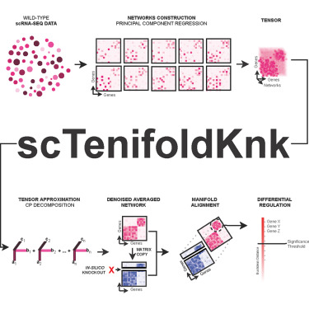
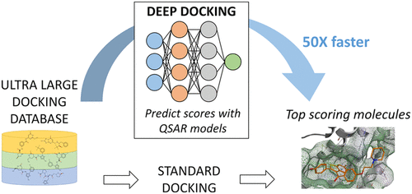


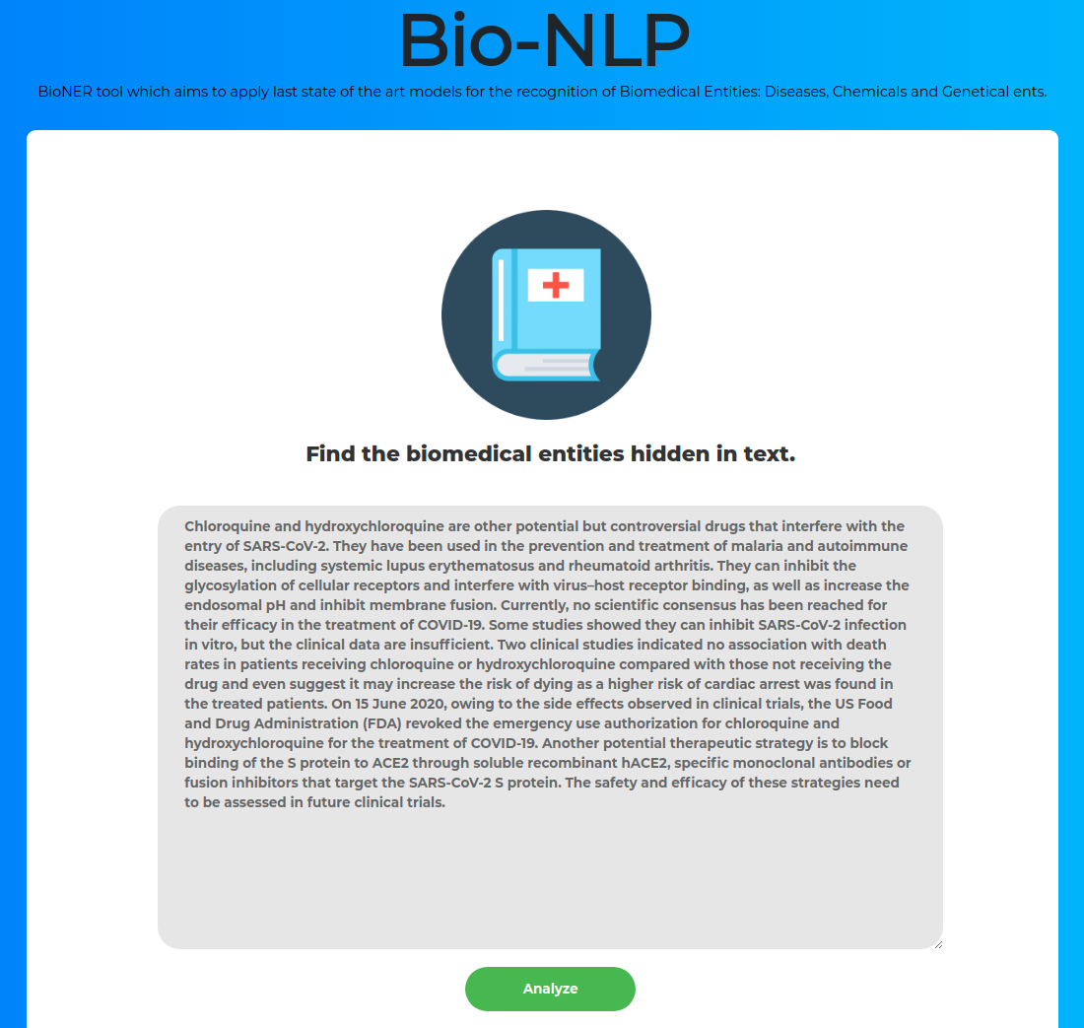
Some Success stories: Empowering Bioinformaticians
Structural Biology
Genomics
Medical LLMs
And AlphaFold Multimer
ProteInfer
DRPBind
DeepSpaCE
DeepMSA
DeepBLAST

Slide 5
How usability,
explainability, traceability, auditability can affect the
realization of AI tools for bioinformatics?
Question 4, group 1

Slide 6
Explainability
Are the outputs understandable?
Is the purpose of the system correctly communicated?
Capability of explaining the technical processes of the system as well as human decisions
Usability
Can an AI tool be used to achieve a goal in a safe way?
Are the UI easily used without many errors?
Does it lead to a better outcome while increasing productivity for others?

Slide 7
Auditability
Events related to the data, e.g. maintain logs on databases regarding operations (who, what, when…)
Assessing an algorithm’s safety and legality
Traceability
Follow lineage of the data: data creation/origin, modifications, access, transfers…
Track down the prediction process of an AI, understand how a decision was made.
Bias detection
Accountability
Assign responsibility to individuals/entities regarding data usage and management

Slide 8


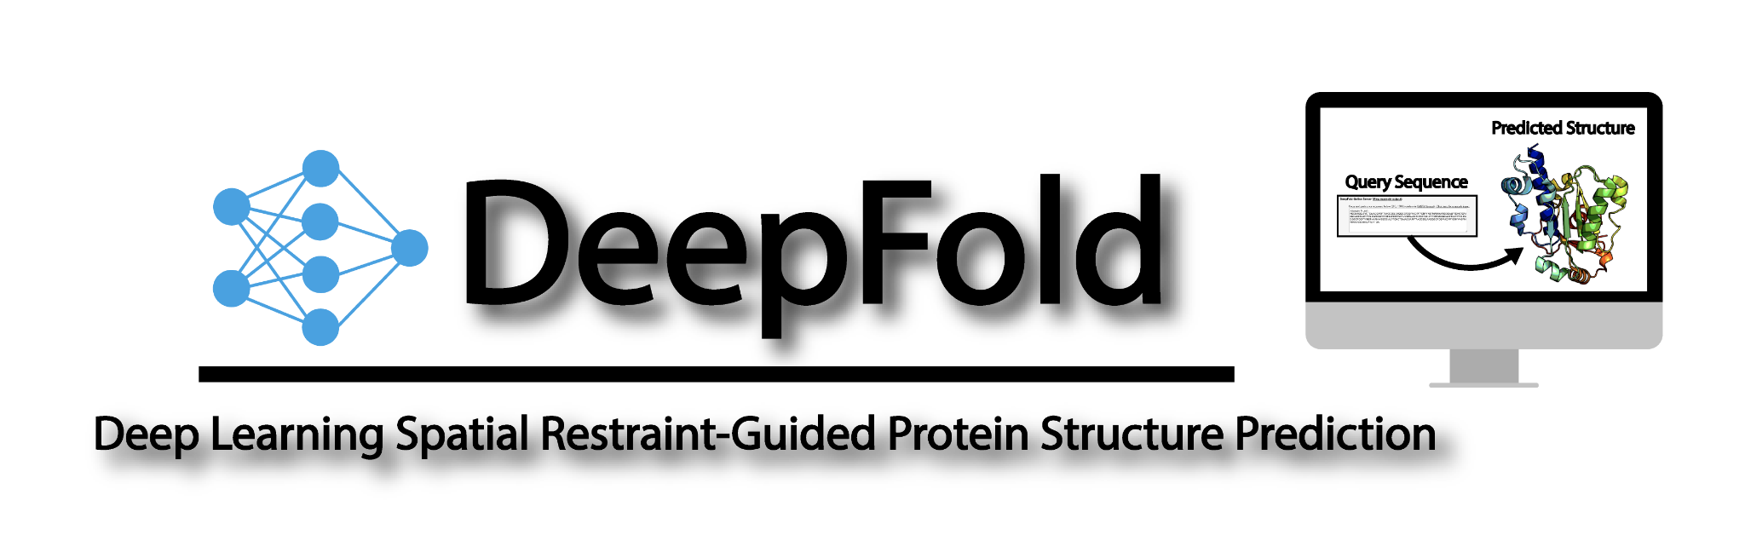
Usability
Researchers (like us) and clinicians may not be AI experts; usability enhances accessibility.
Intuitive Dashboards: Intuitive dashboards in bioinformatics are designed to present key information related to biological data, AI model outputs, or analysis results in a visually accessible format.
Use of interactive charts, graphs, and summary statistics to provide a comprehensive overview of the data or model performance.
Simplified Workflows: Simplified workflows in bioinformatics aim to make the usage of AI tools and the analysis of biological data more accessible to a broader audience.
Automating routine tasks
Reducing the number of Manual steps
Providing clear guidance on how to proceed through each stage of the analysis.

Slide 9
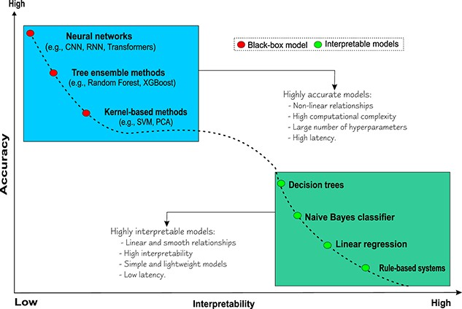
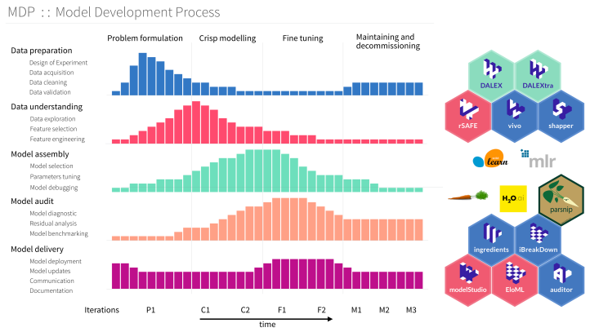
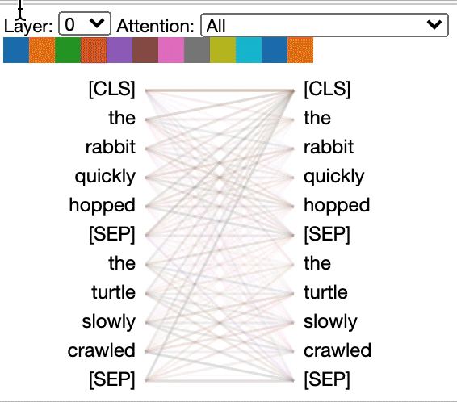
Explainability (xAI)
TensorFlow Playground
Explainable AI
Ability to understand clearly and openly how a model arrives at a particular decision or prediction. Eg:
Decision trees: Each internal node of the tree represents a decision based on a specific feature, and each leaf node represents the predicted outcome.
Feature importance plots: Feature importance plots visually represent the contribution of each feature to the predictive performance of a machine learning model
Model-agnostic interpretability tools: These tools aim to provide insights into the model's decision-making process without relying on model-specific characteristics. Eg: Drwhy.AI, BERTViz and more.
BERTViz
Karim, M. R., Islam, T., Shajalal, M., Beyan, O., Lange, C., Cochez, M., ... & Decker, S. (2023)
Biecek, P., & Burzykowski, T. (2021).
Vig, J. (2019).

Slide 10
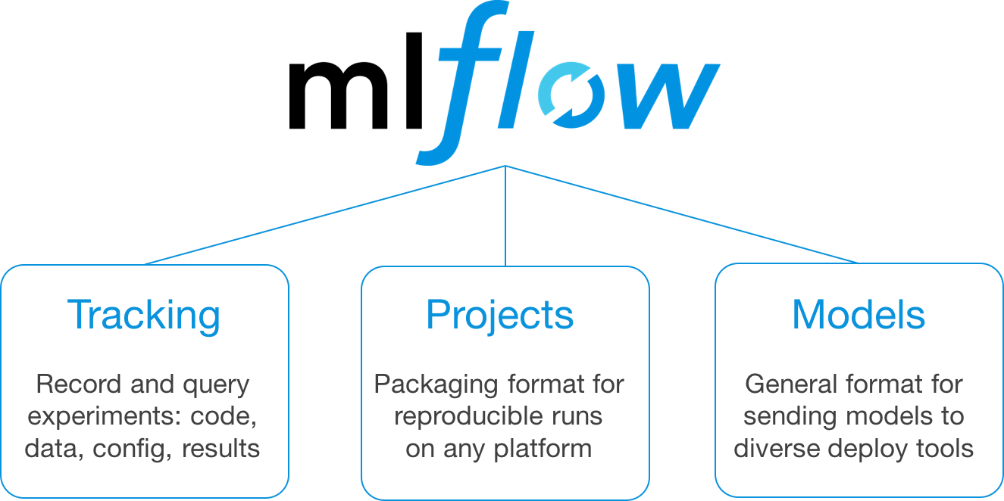
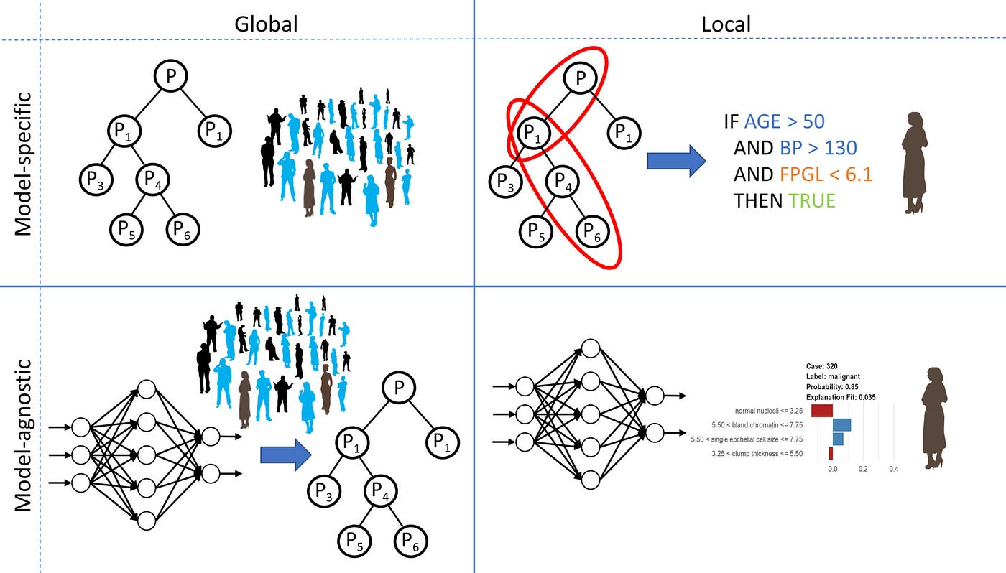
Traceability
Reproducibility, helps identify data issues, and addresses biases.
Detailed documentation of data preprocessing steps: Recording and describing the processes applied to raw data before it is fed into a machine learning model. Accounts of how the data has been prepared for analysis.
Version control for models: Systematic way to organize, document, and retrieve different versions of models throughout the development and deployment process.
Traceability

Slide 11


Auditability
Explanation of the need for monitoring and logging: Ensures ongoing performance, identifies issues, and supports regulatory compliance.
Logging data inputs: Source of the data, timestamp, and specific features or variables used as input.Traceability and reproducibility.
Tracking model predictions: Predicted classes or values, confidence scores, and any associated metadata. Assessing model performance, identifying errors, and validating the model's output against ground truth
Monitoring system changes: Tracking any modifications, updates, or enhancements made to the AI system. Ensure that the system remains robust.
mlr3: Machine Learning in R

Slide 12
Requirements for trustworthy AI by the European Commission
Human agency → Human autonomy , informed decisions, fully understand how to interact with the tool, AI tools should be supervised by human

Slide 13
Requirements for trustworthy AI by the European Commission
Human agency
Technical robustness and safety → Resilience to attacks, safety plans, correct judgements (accuracy), reproducibility

Slide 14
Requirements for trustworthy AI by the European Commission
Human agency
Technical robustness and safety
Privacy and data governance → data privacy and protection, good data quality, address social-constructed biases, inaccuracies and errors. Regulate who can access the data.

Slide 15
Requirements for trustworthy AI by the European Commission
Human agency
Technical robustness and safety
Privacy and data governance
Transparency → traceability, explainability and accuracy trade-off, clear communication: and AI system should always be identifiable as as such.

Slide 16
Requirements for trustworthy AI by the European Commission
Human agency
Technical robustness and safety
Privacy and data governance
Transparency
Diversity, non-discrimination and fairness → Data sets can be affected by historical bias, incompleteness, etc. Harm can also arise from intentional exploitation of known biases. AI systems should be universally accessible.

Slide 17
Requirements for trustworthy AI by the European Commission
Human agency
Technical robustness and safety
Privacy and data governance
Transparency
Diversity, non-discrimination and fairness
Societal and environmental wellbeing → Can AI systems enhance or deteriorate social skills? What effect will they have in institutions?

Slide 18
Requirements for trustworthy AI by the European Commission
Human agency
Technical robustness and safety
Privacy and data governance
Transparency
Diversity, non-discrimination and fairness
Societal and environmental wellbeing
Accountability → Auditability (internal and external evaluation), plans for minimization of negative impact, protection for entities who raise concerns.

